Slide 1

Introduction to Machine Learning in Python
Machine Learning
K-Nearest Neighbor (KNN)

Slide 2

Need to know
https://www.datacamp.com/community/tutorials/introduction-machine-learning-python
numpy, matlibplot,, sklearn

Slide 3
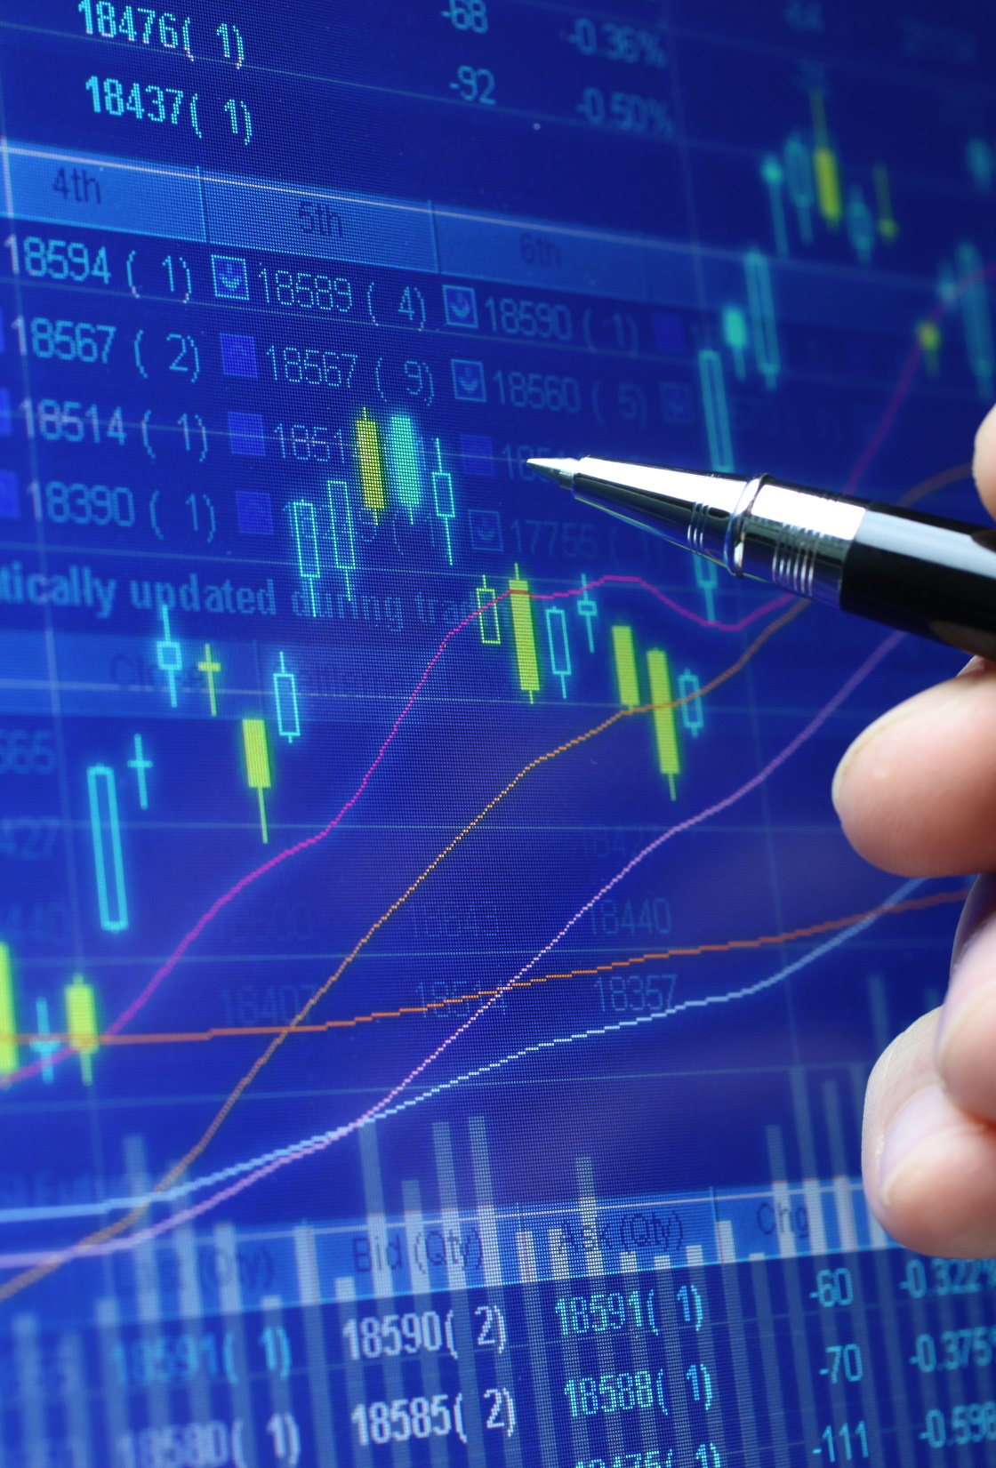
Thank you
someone@example.com

